Slide 1

Trustworthy Digital Identity:
Trustchain project
28th September 2022
Dr Sam Greenbury
Research Engineering Group
The Alan Turing Institute
Notes:
Joint work with colleagues from the REG team and the TDI project

Slide 2
What is Trustworthy Digital Identity?
Traditionally identification is done through physical means
Digital identity systems promise to facilitate efficient, secure and convenient access to services for citizens
Examples include: proof of identity, qualifications, access to resources, etc

Slide 3
Trustworthy Digital Identity
Challenges arise in delivering this promise:
Functional (e.g. Integrity – tamper proof data)
Operational (e.g. Efficient and reliable – system is usable)
Privacy (e.g. Minimal and relevant disclosure)

Slide 4
Aim of Trustchain project at a glance
To construct an infrastructure for trustworthy digital ID, using cryptographic and decentralized technologies, and develop prototype software to deliver the system

Slide 5
Motivating decentralization
Decentralization potential in digital ID:
Privacy (against user profiling)
Agency (users are in control of their data)
Security (avoids new centralised data stores)
Resilience (uptime, accessibility)
Interoperability (between centralised systems)
These are all important properties worth developing solutions!

Slide 6
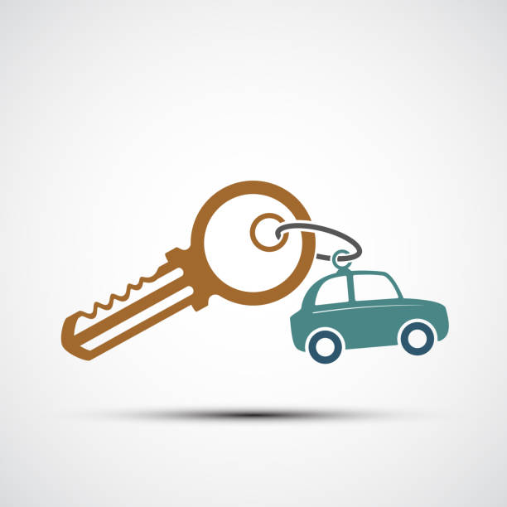
Example use case of decentralized ID and verifiable credential
UK Customer wants to rent a car in France. Must prove they have a license
Customer can provide digitally signed license (verifiable credential) from an issuer (e.g. DVLA)
Rental shop can then scan the credential and verify the signature from issuer is valid by looking up the issuer in the decentralized network
No physical document, rental shop can verify without talking to issuer, customer only need disclose the ability to drive (minimal disclosure)

Slide 7
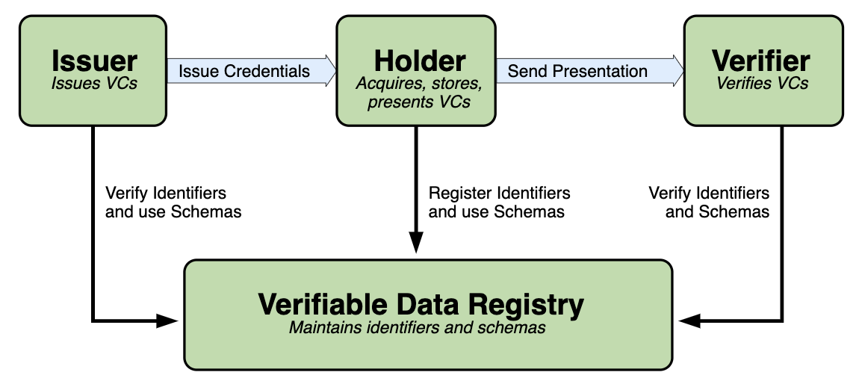
Decentralised Identifiers (DID) & Verifiable Credentials (VC)
Image source: https://www.w3.org/TR/vc-data-model/
Notes:
This is the way forward:
- EBSI
- MOSIP
- Open protocols >> Closed/centralised platforms
But Verifiers must be able to identify Issuers by their pub keys.
i.e. The whole thing depends on the public key infrastructure provided by the Verifiable Data Registry

Slide 8
Decentralized technologies but…the Oracle problem
InterPlanetary File System (IPFS) provides content addressable storage (CAS) peer-to-peer storage network
Decentralized ledgers, such as blockchains like Bitcoin, can produce verifiable timestamps through proof of work
Together these make a universally accessible verifiably timestamped message board
Perfect for decentralized storage and retrieval of DID
The Oracle problem: how can you trust that the data stored in the ledger truly represents the reality it purports to?

Slide 9
Trustchain solution
Provides an approach for DIDs given two insights:
Timestamping can provide a one-off solution to the Oracle Problem
If DIDs can be linked in chains of trust, a one-off solution is sufficient

Slide 10
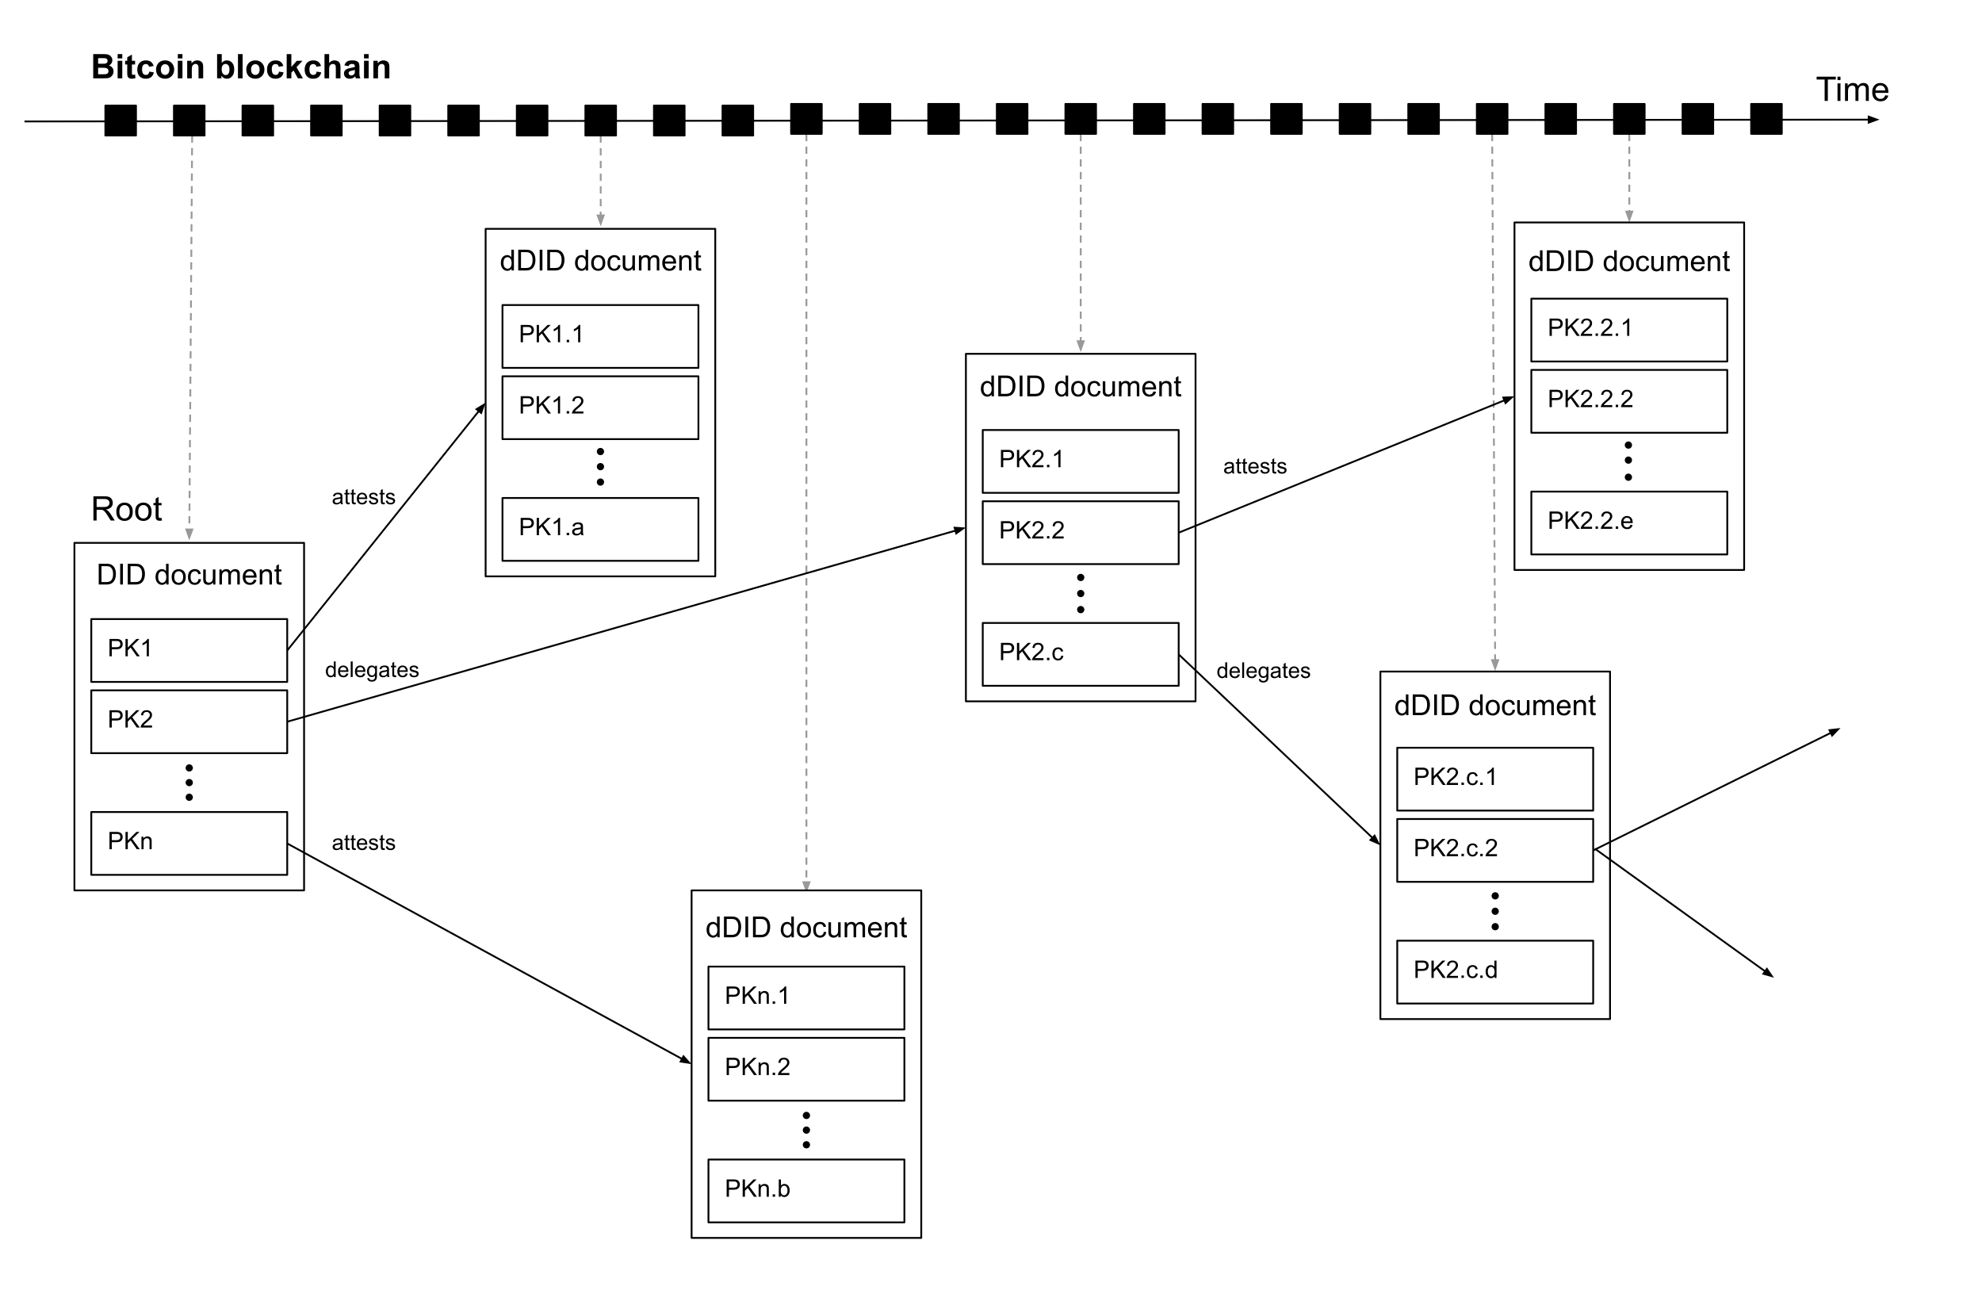
Trustchain schematic
3. Further IDs are attested to by DIDs in 2
1. Root trust event of major societal authorities to provide a one-off solution to the oracle problem
4. Trustworthiness of DIDs is traceable backwards through verification of the digital signatures along a path
2. Time passes (reducing the risk of ledger mutability) and downstream IDs are attested to by root DIDs

Slide 11
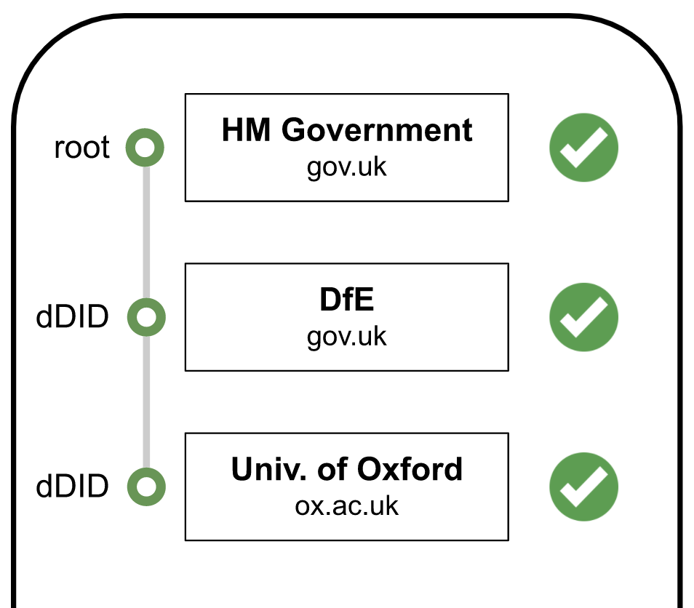
Example chains of trust
Central government → DfE → Universities
Central bank → Licensed banks → SMEs
Industry regulator → Corporation → Subsidiaries

Slide 12
Project activities
Background: Researching the international frameworks for DID, W3C standards, principles, use cases
Technological scoping: exploratory use of ION (software for working with IPFS and bitcoin with DIDs)
Algorithm development: technical work designing central algorithmic processes
Software development: open-source development in Rust (efficient, flexible and safe) to build the fully functional system

Slide 13
Project milestones
Trustchain v1.0 (end of 2022): an open-source prototype system by end of 2022 functioning from the command line (proof of concept)
Trustchain v2.0 (mid-2023): a full mobile app with extended functionality for working with credentials and specific use cases

Slide 14










Questions?

Slide 15
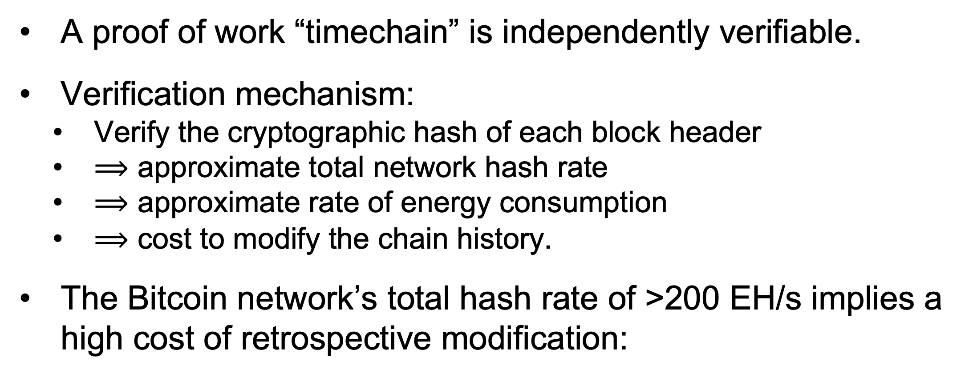
Verifiable Timestamping
A proof of work “timechain” is independently verifiable.
Verification mechanism:
Verify the cryptographic hash of each block header
$⟹$ approximate total network hash rate
$⟹$ approximate rate of energy consumption
$⟹$ cost to modify the chain history.
The Bitcoin network’s total hash rate of >200 EH/s implies a high cost of retrospective modification:
0 | 1 hour | 1 day | 1 week | 1 month
<$1 | $1.7m | $41.4m | $290m | $1.26b
Source: https://www.crypto51.app/

Slide 16
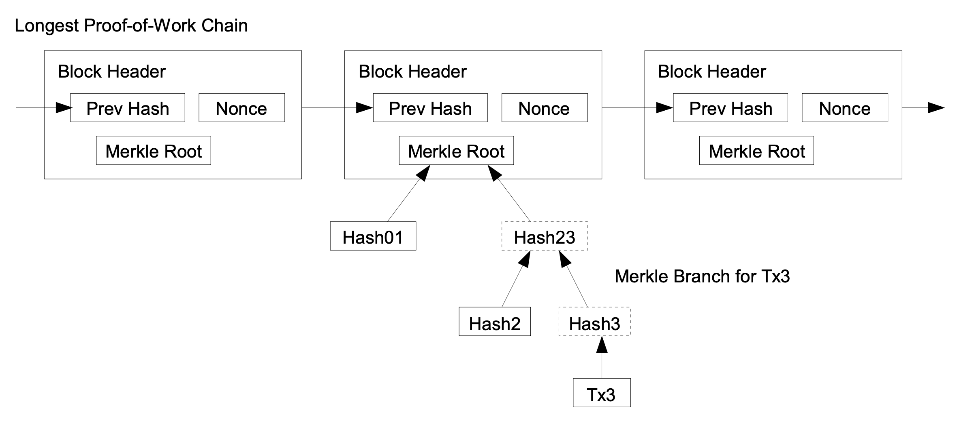
How does Simplified Payment Verification (SPV) work?
SPV enables timestamp verification on light (e.g. mobile) clients.
Verification requires only the block headers (~58 MB).
No need to download & store the entire blockchain (~320 GB).
Each proof is a Merkle branch of ~350 bytes requested from other nodes on the network.
Image source: Bitcoin: A Peer-to-Peer Electronic Cash System, S. Nakamoto (2008)

Slide 17
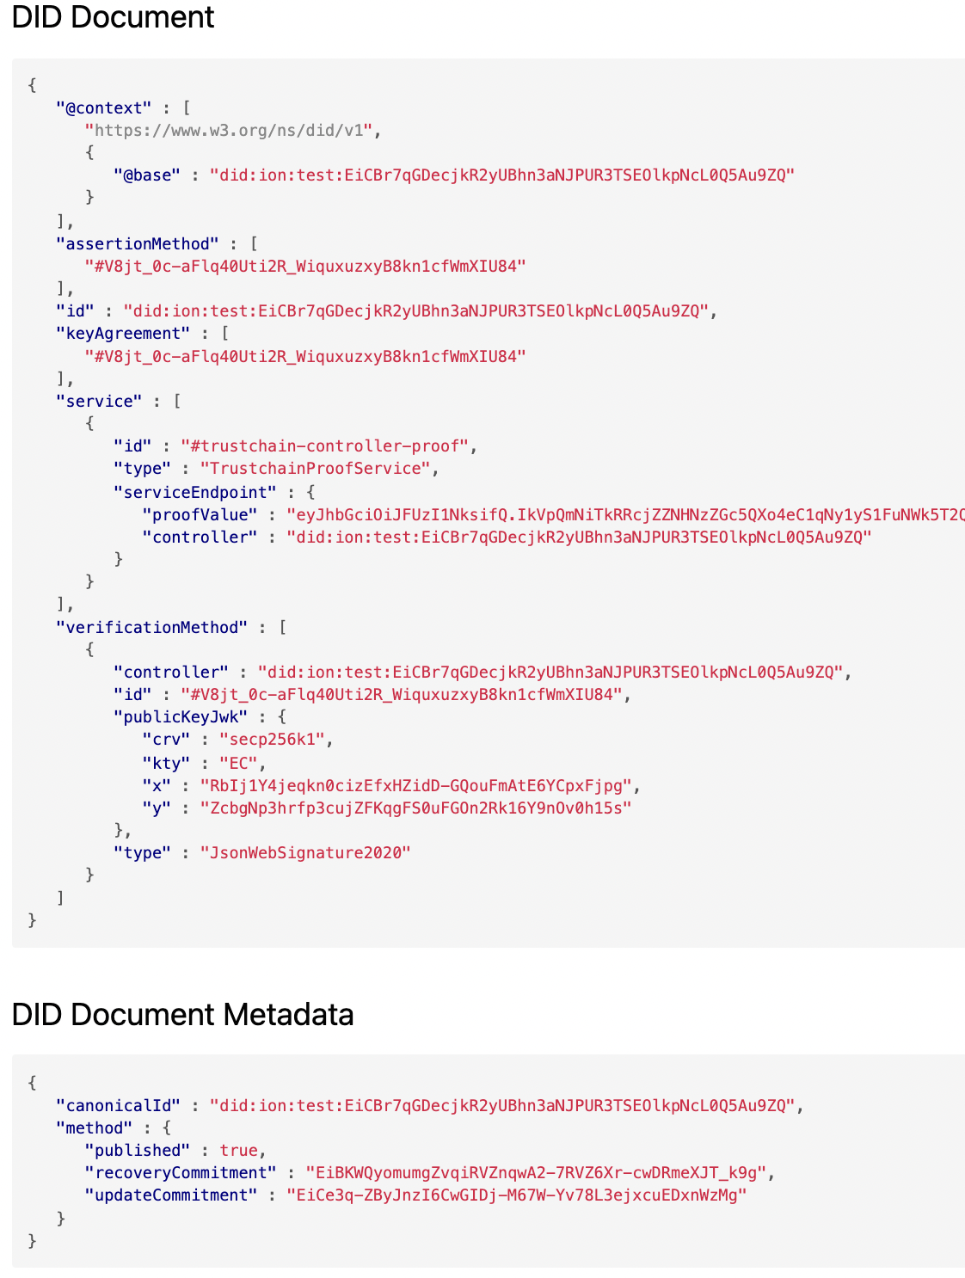
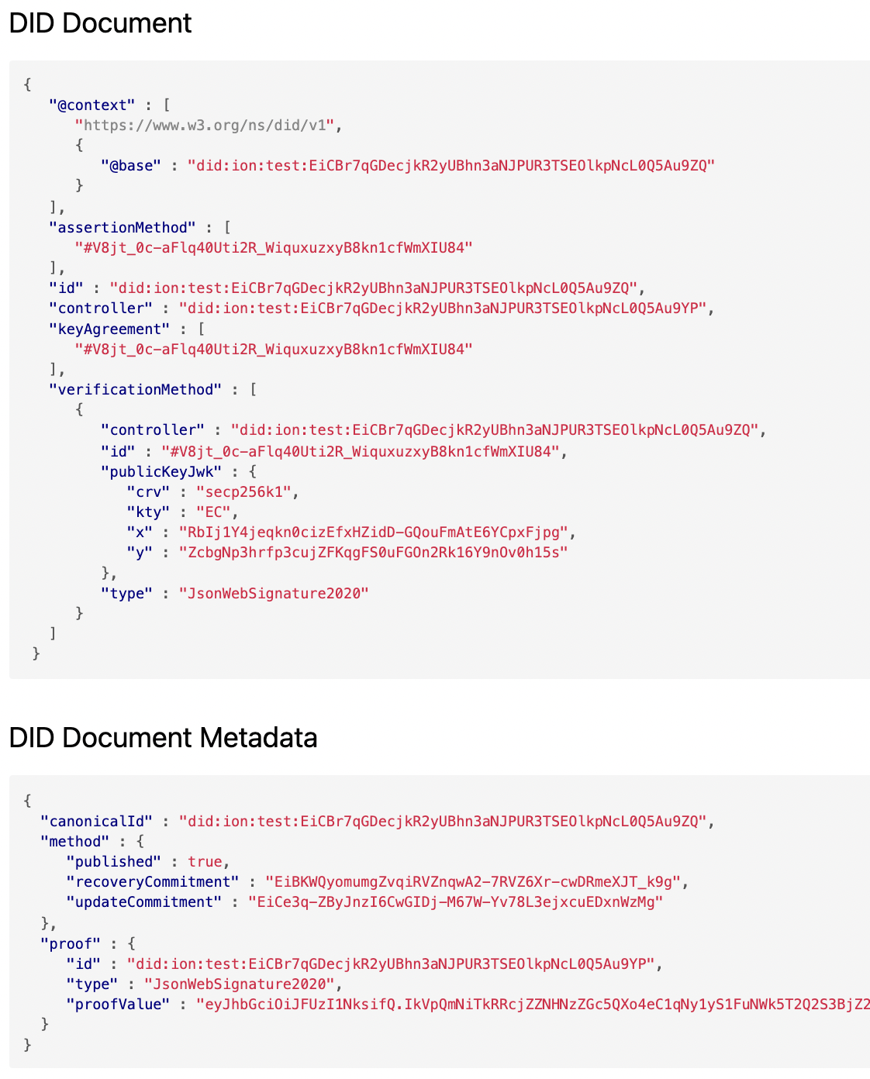
Downstream DID (dDID)
Resolved DID
Trustchain dDID
Transform

Slide 18
Features
Transparent attestation by recognisable, qualified institutions
no dependence on generic Certificate Authorities
data layer is exceptionally tamper-evident and tamper-resistant
Granular delegation of permissions
permission to extend the chain of trust and/or issue VCs
cryptographically enforceable by multi-signature constraints
Nodes can be “rebased” onto another chain
possible assimilation of pre-existing VC infrastructure, such as CAs
VCs already issued remain valid

Slide 19
Features
Interoperability dDIDs create loosely-coupled federations
enabling VCs issued under one system to be validated in another
Revocation mechanism built into the W3C DID standard
somewhat analogous to Certificate Transparency
verifiable timestamps ensure unambiguous order of DID publication
Any community can create their own root of trust
open network & protocol, permissionless access
open for software developers to develop tooling/extensions
Light clients can be supported via SPV proofs
permitting timestamp verification on mobile devices

Slide 20
Development milestones
Planned extension of the W3C DID standard to embed signature data
dDID publication (proof of concept) via ION (Identity Overlay Network)
Software development in Rust
Core features by end of 2022
Mobile app development
ION SPV node, Verifiable Credentials/Presentations
Advanced features
delegation constraints, rebasing, interoperability
Automation
challenge-response protocols, key rotation, etc.

